Slide 1
Create Admin’s Home Page
Task List:
Create admin home page (index.jsp)
Create admin home servlet (AdminHomeServlet.java)
Create admin header (header.jsp)
Create admin footer (footer.jsp)

Slide 2
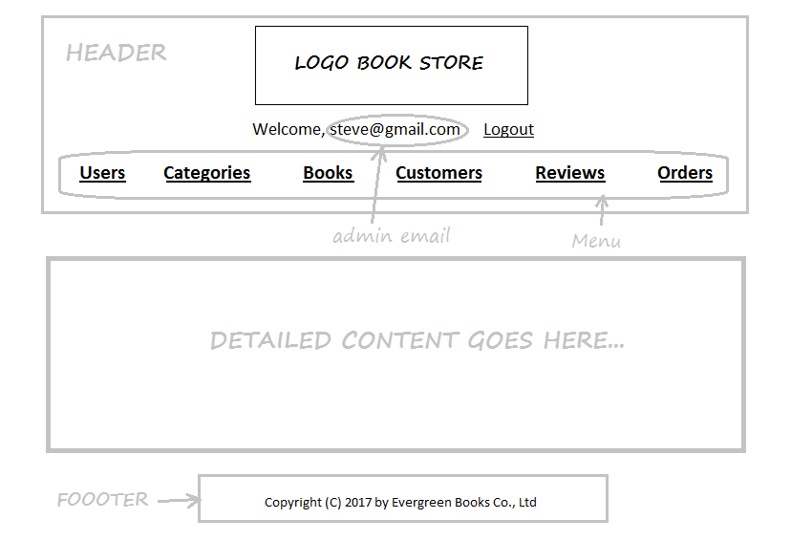

Slide 3
